Slide 1
High Resolution Digital Audio
&
Vinyl

Slide 2
This is the 1st issue of
“The Absolute Sound”
founded by Harry Pearson
in 1973
He defined “The Absolute
Sound” as
“the sound of actual
acoustic instruments
playing in a real space”.

Slide 3
High resolution audio is sound that more closely resolves
the original sounds created by real instruments.

Slide 4
The higher the quality of the recording,
the more high resolution audio will show-off its merits.

Slide 5
Hi-resolution Analog tape:
What is state-of-the-art playback of tape?

Slide 6
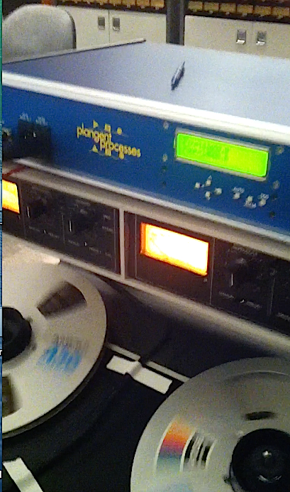
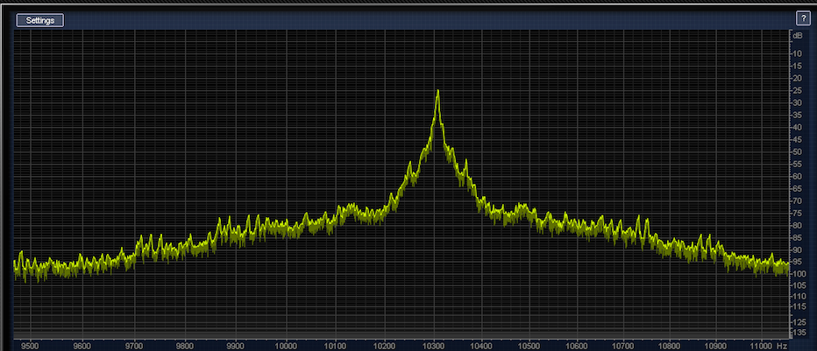
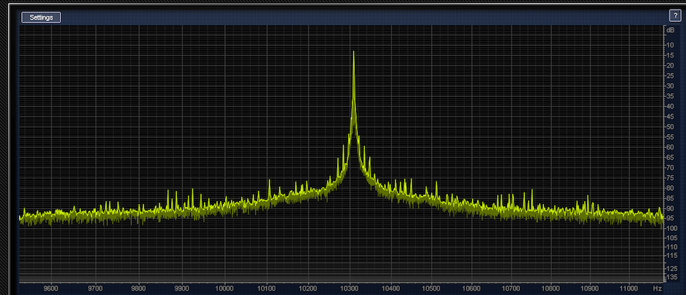
The plangent process
reduces wow & flutter by recording the bias embedded in the original master tape with a 3rd output channel and then time base corrects the stereo output:

Slide 7
the plangent process has been used on many projects including
All re-mastered Bruce Springsteen analog tapes
Grateful Dead
Queen multi-track
The Rolling Stones
Mercury “Living Presence” classical

Slide 8
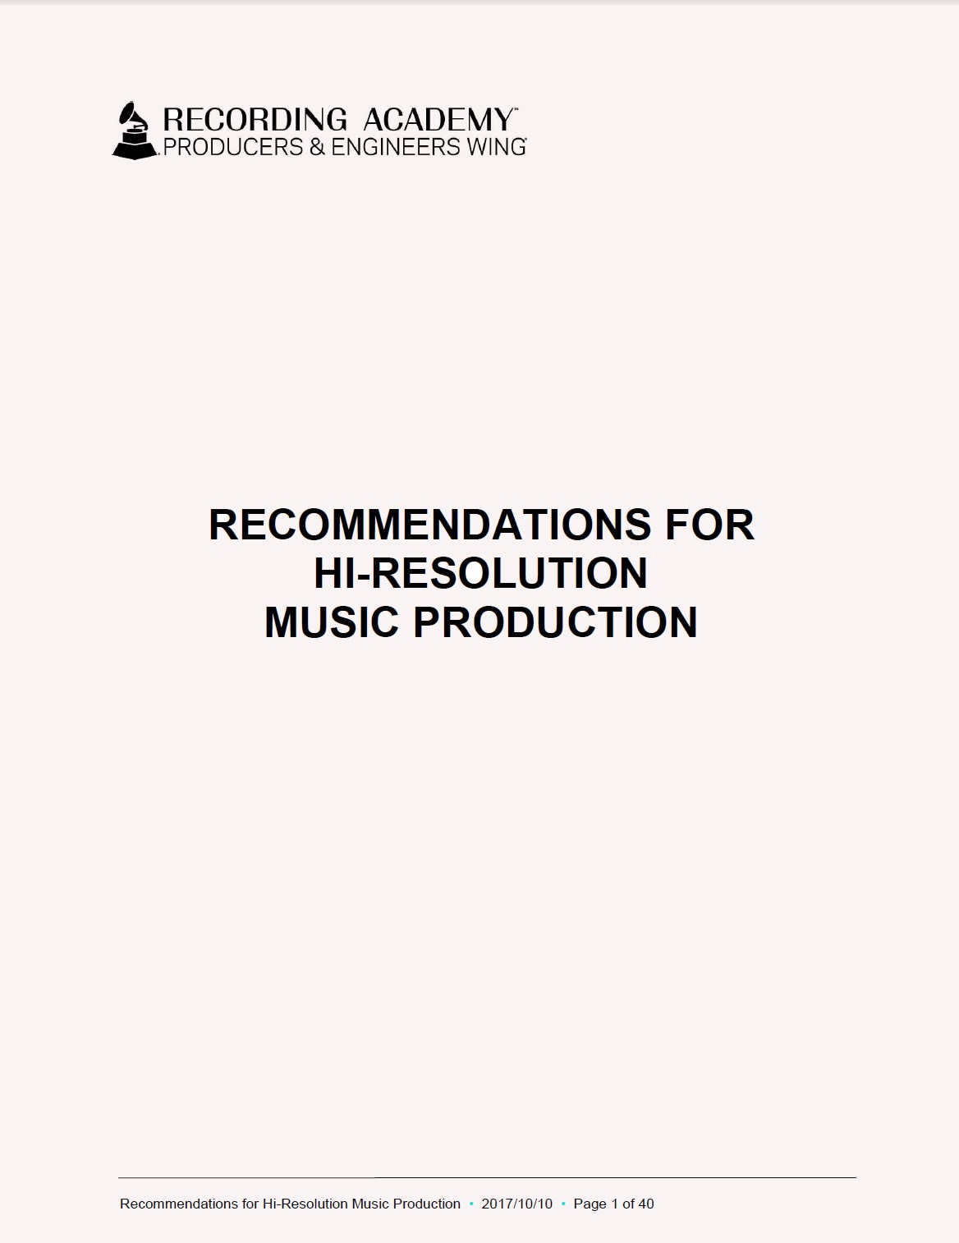

Slide 9
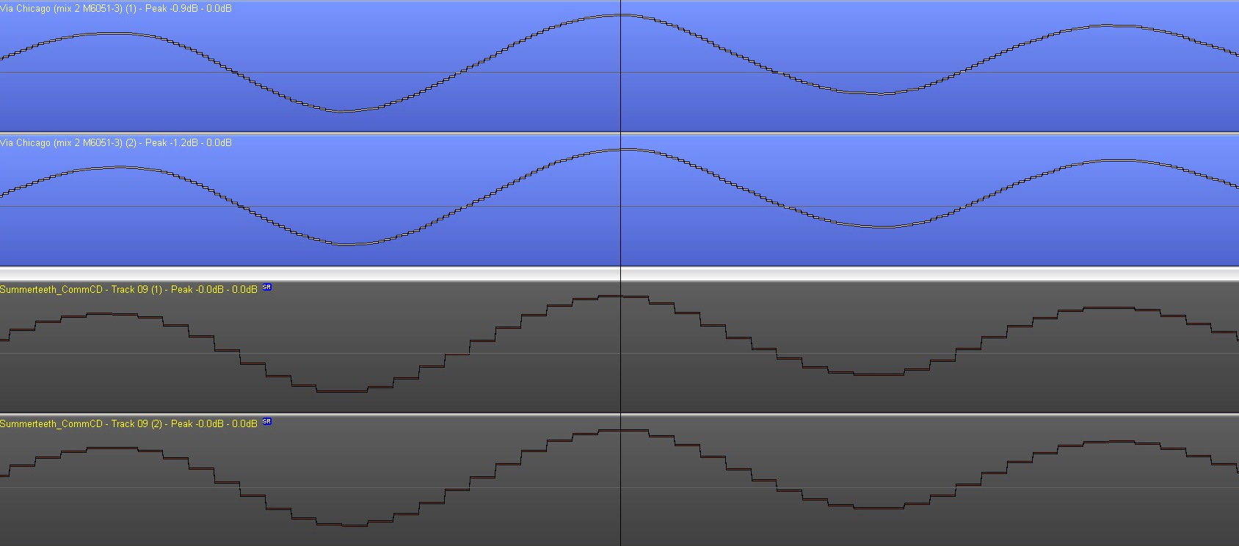
The Producers & Engineers Wing of
The Recording Academy just published
Recommendations for High Resolution Music Production
www.producersandengineers.com
192kHz
44.1kHz

Slide 10
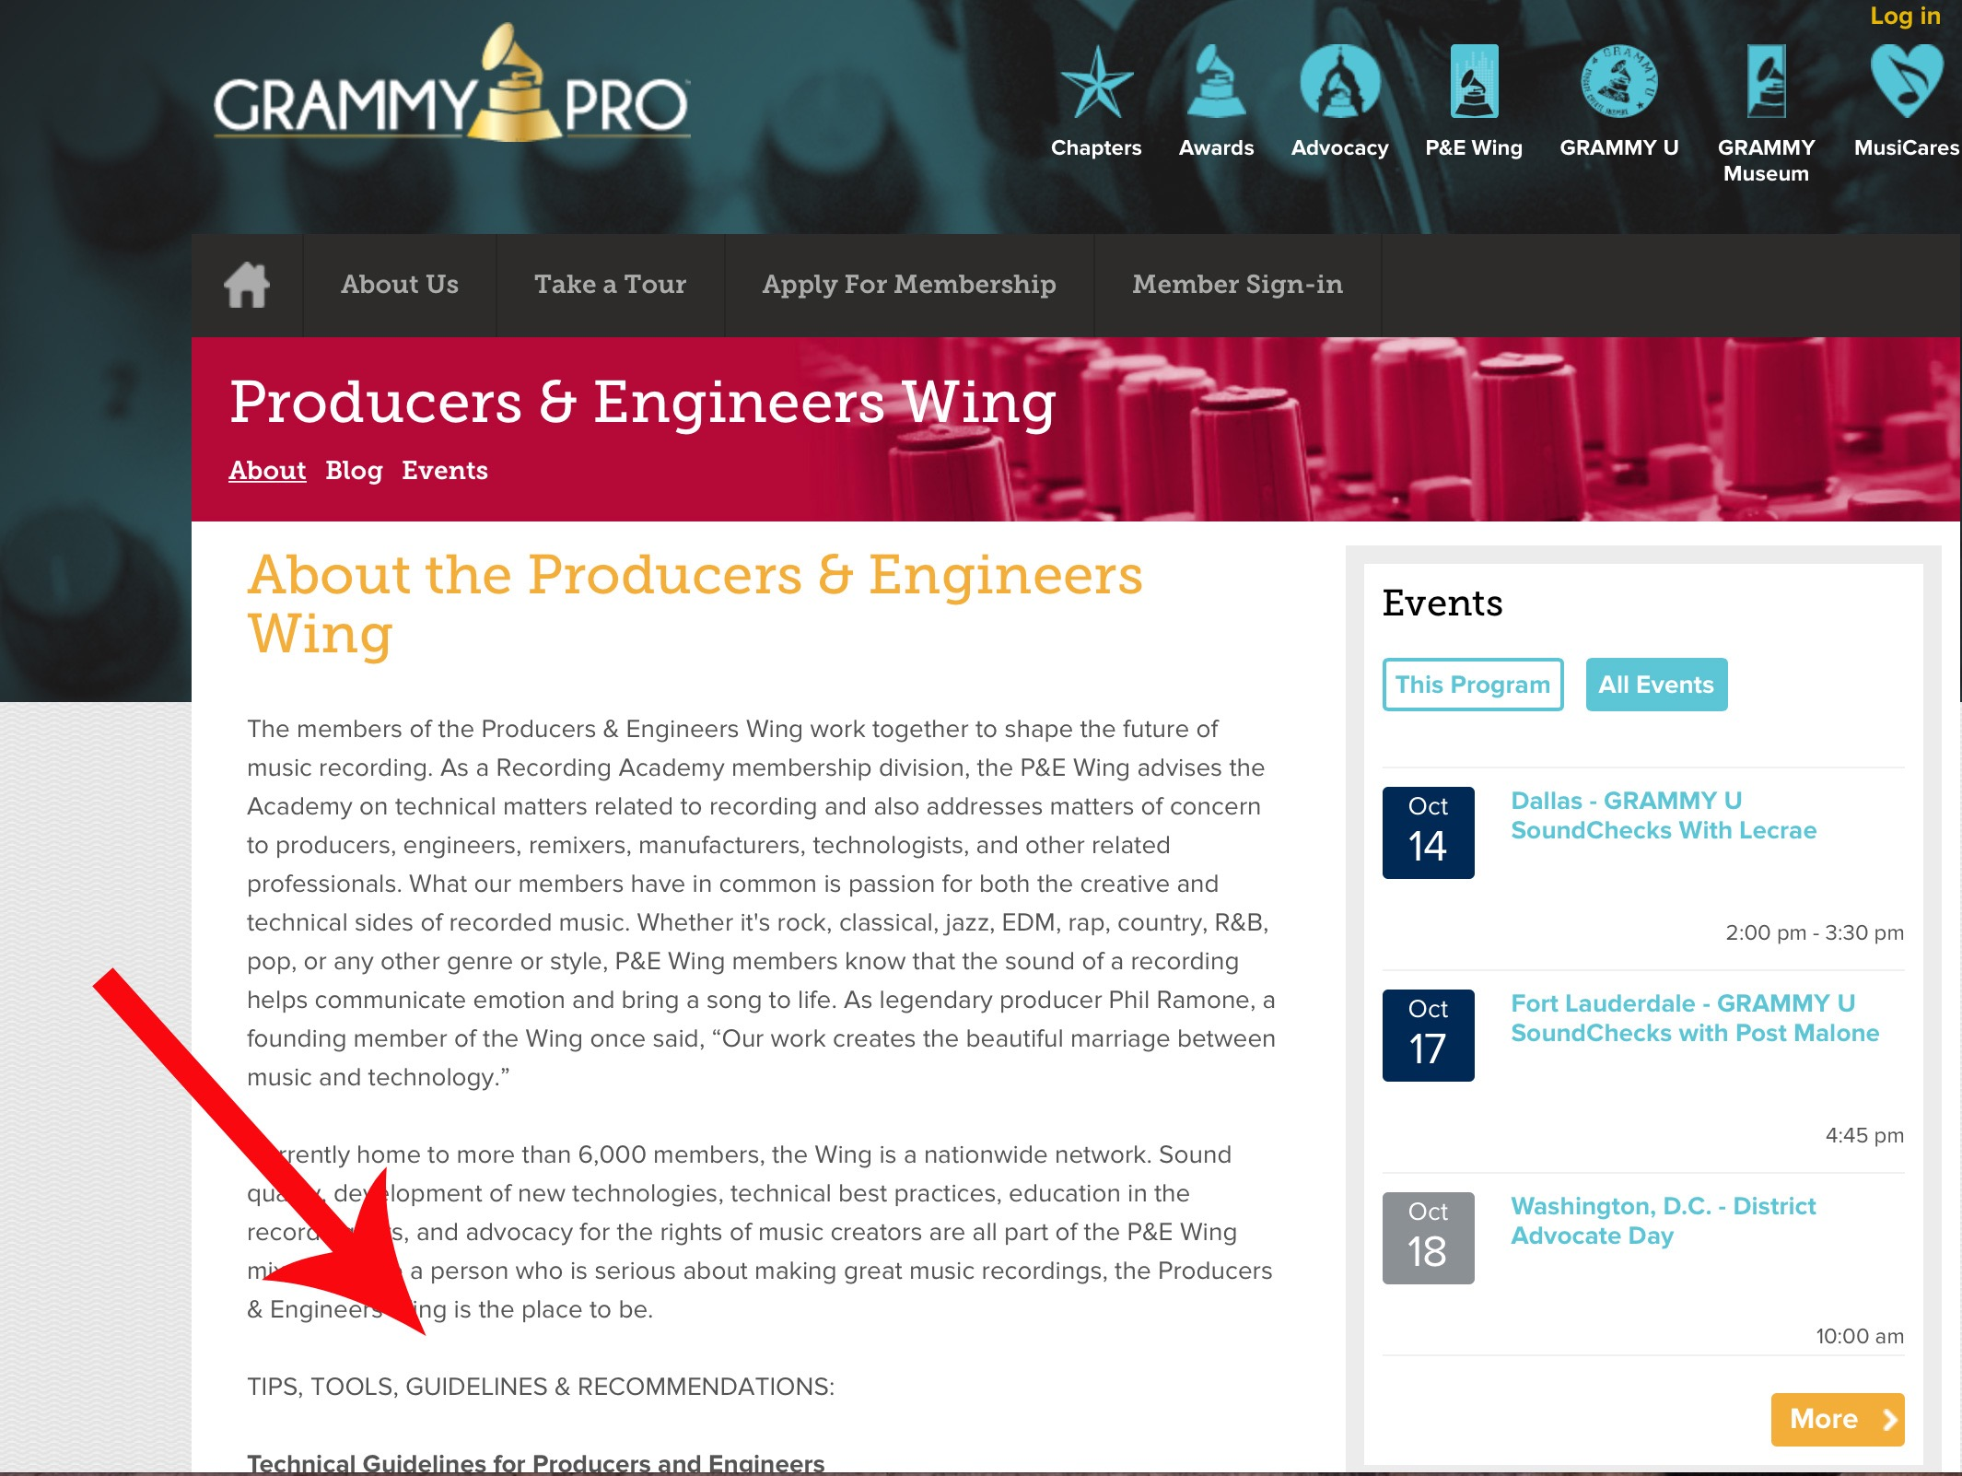

Slide 11
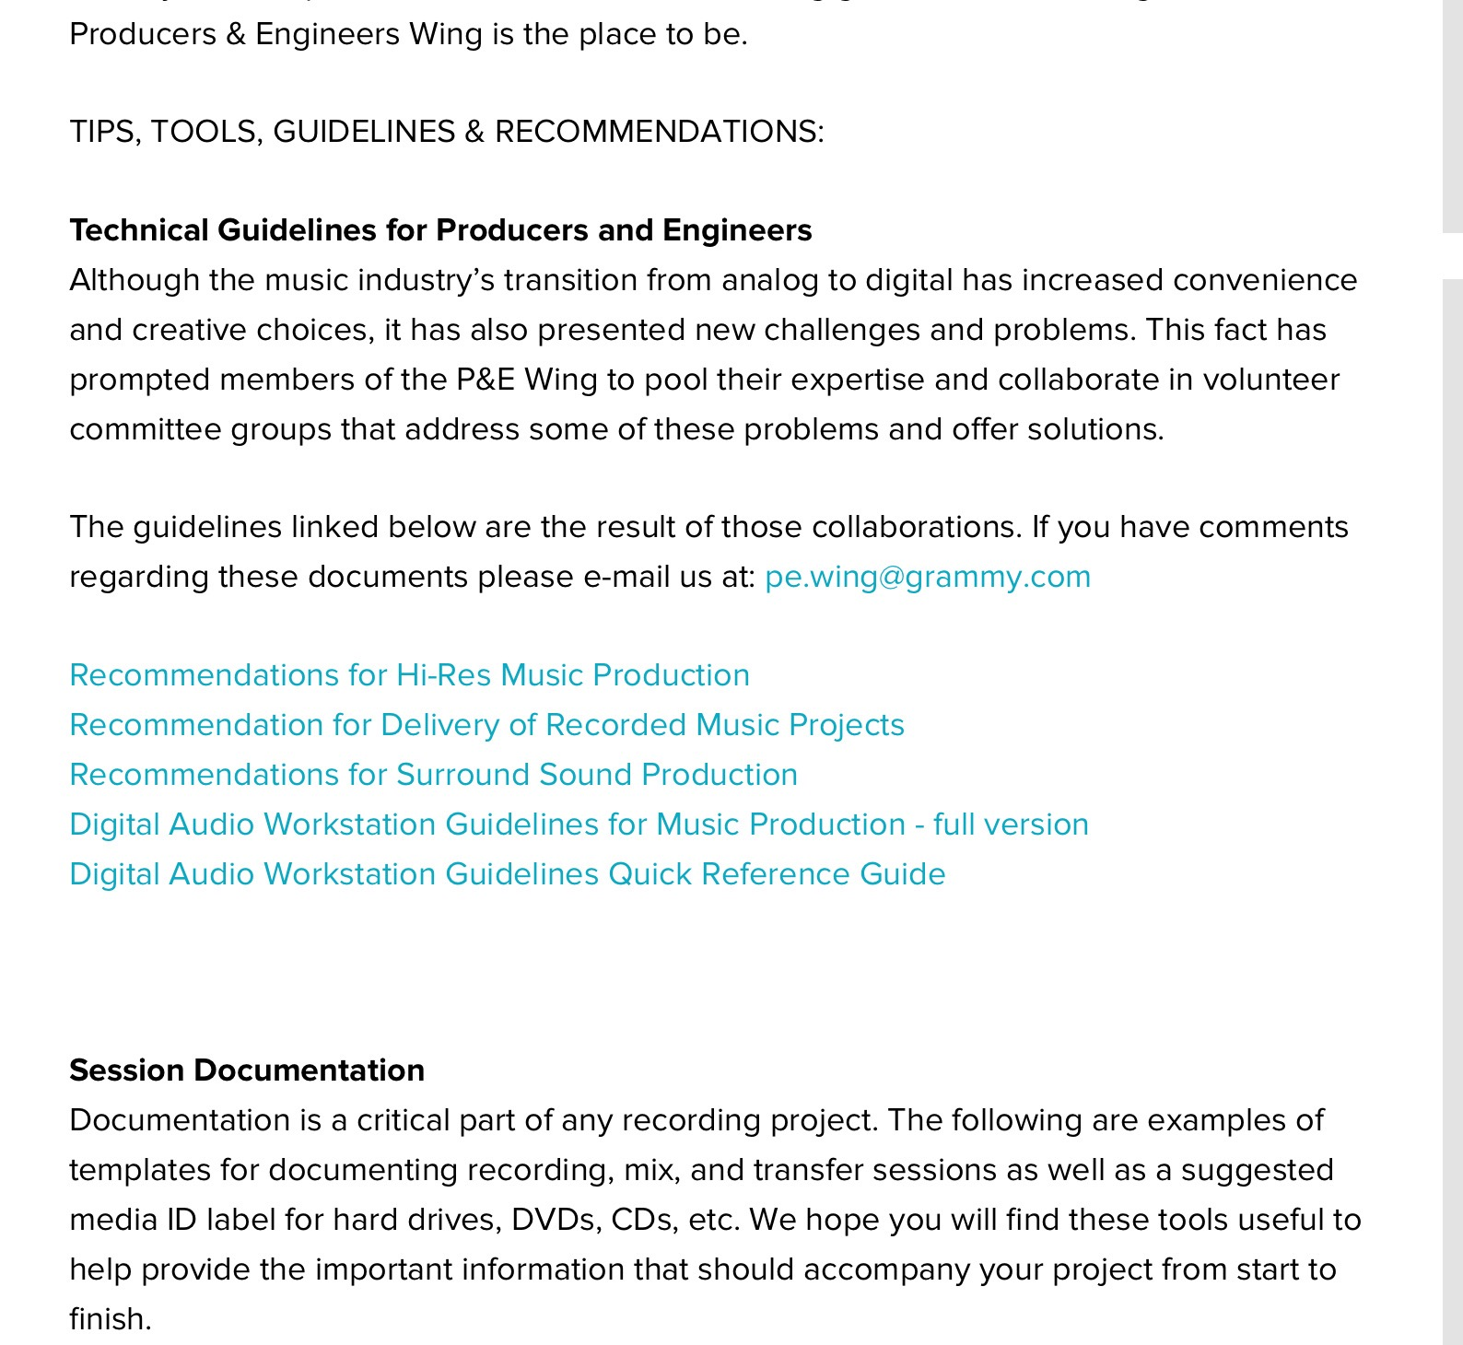

Slide 13
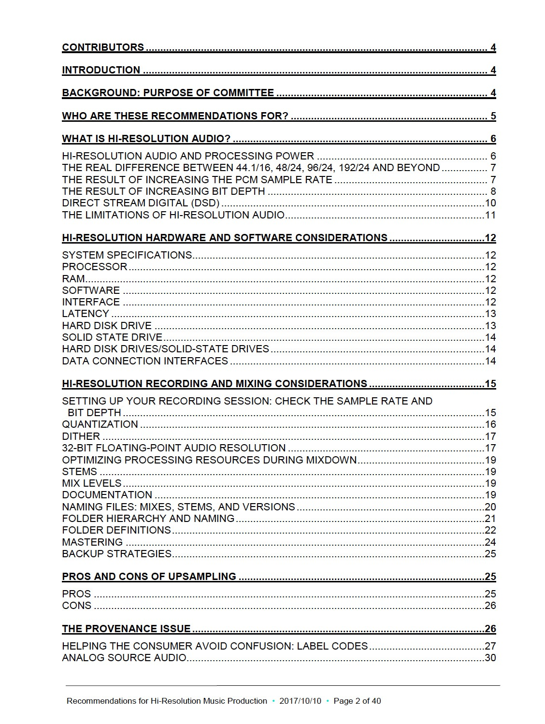

Slide 14
The RIAA, Digital Entertainment Group and other organizations involved with high resolution digital asked the Producers & Engineers Wing for recommendations.
Their definition is:
“hi-res audio is lossless audio that is better than CD-quality in both sample rate and bit-depth.”

Slide 15
The RIAA, Digital Entertainment Group and other organizations involved with high resolution digital asked the Producers & Engineers Wing for recommendations.
Their definition is:
“hi-res audio is lossless audio that is better than CD-quality in both sample rate and bit-depth.”
Thus 48kHz/20 bit can be marketed as high resolution audio and it may have the HR Logo

Slide 16
The P&E Wing Recommendations are for at least
48kHz/24 bit with 96kHz/24 bit being the sweet spot
of quality vs. DAW performance.

Slide 17
The P&E Wing Recommendations are for at least
48kHz/24 bit with 96kHz/24 bit being the sweet spot
of quality vs. DAW performance.
Go home, go to your workstation and switch it
from 44.1 to 48kHz and you can sell
Hi-resolution digital for $$ !!

Slide 18
Some highlights of the Hi-Resolution document:
Set your system defaults to 96kHz/24 bit if possible.
That is the sweet spot of quality vs. performance.
Definitely record at 24 bits, not 16!
If track counts & plugins pile up use 48kHz/24
NOT 44.1kHz
(it disqualifies your client from HDtracks money!)
Use a 64bit OS and software if possible.

Slide 19
AES inputs can only deal with 24 bits.
Record into the DAW at 24 bits.
If you are going to mix in the DAW, reset the session to
use 32 bit-float to better capture the signal processing.
Store all mixes as 32 bit.
Add dither when bouncing or out-putting to 24 or 16 bit.

Slide 20
Provenance:
It’s important with High resolution sessions
to document the session:
i.e.: It is legitimate to mix a 44.1kHz/16bit multi-track
through an analog desk and record the output
at 96kHz/24 to more faithfully capture the sound of
the analog processors.
But people buying those tracks should know
the provenance of it to be informed.

Slide 21
Back up strategies:
Use the 3-2-1 rule:
Back up to 3 drives stored in 2 locations
and only work from 1 drive!

Slide 22
How & where do we listen to High Resolution files?

Slide 23
How and where do we listen to High Resolution files?
SACD Players have offered hybrid discs with DSD stereo, 5.1 and a CD layer since 2002.
Currently about 50 labels are making SACDs

Slide 24
How and where do we listen to High Resolution files?
This is a Meridian “Sooloos” digital server.
It can seamlessly play any sample rate up to 192kHz.

Slide 25
How and where do we listen to High Resolution files?
most iOS devices don’t support more than 48kHz, but iTunes (Apple Core Audio) can digitally output very high rates .
Pono,
Sony,
Astell & Kern etc.
portable players
sound very good
using quality
headphones.

Slide 27
How and where do we listen to High Resolution files?
iTunes software can digitally output very high sampling rates and bit depths.
However, one must MANUALLY re-set the sampling rate in the core audio for each new change in the source sampling rate.
If you do not, iTunes will automatically down-convert the file to 44.1kHz or 48kHz

Slide 28
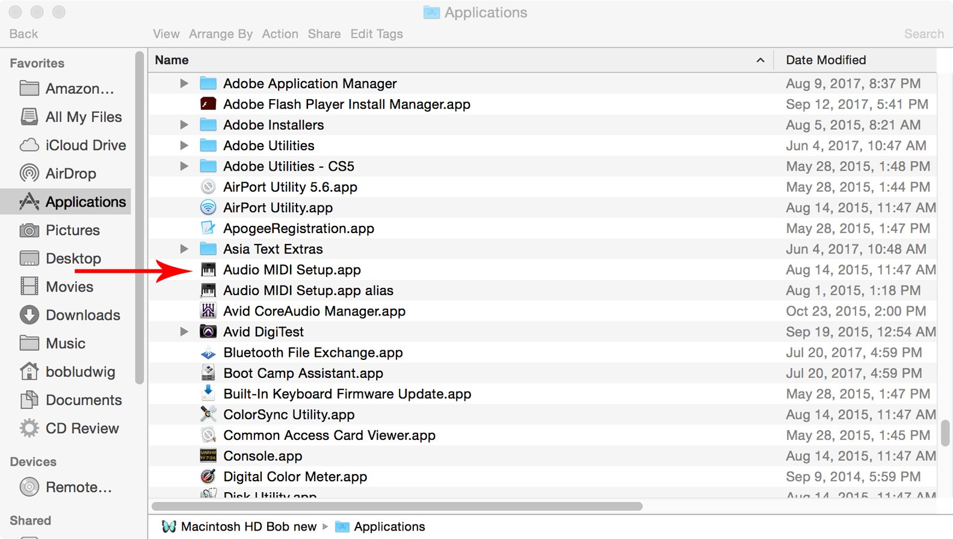
How to change iTunes to digitally output the true sampling rate of your track:

Slide 31
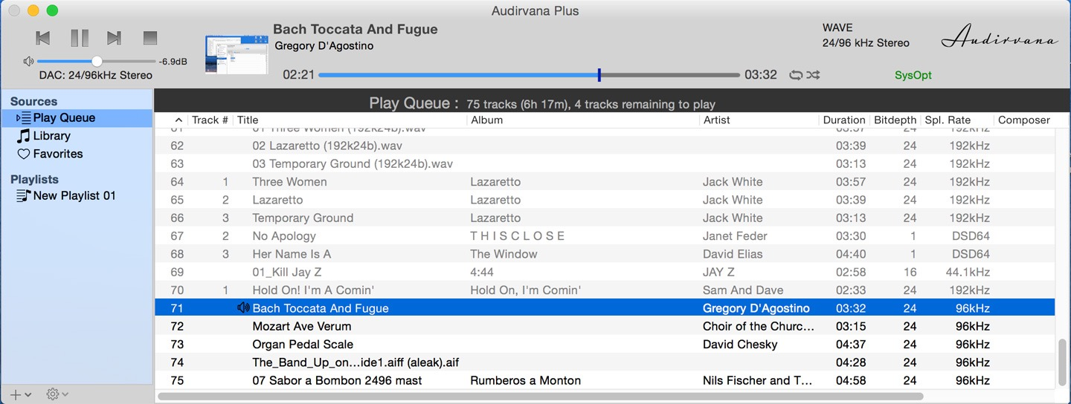
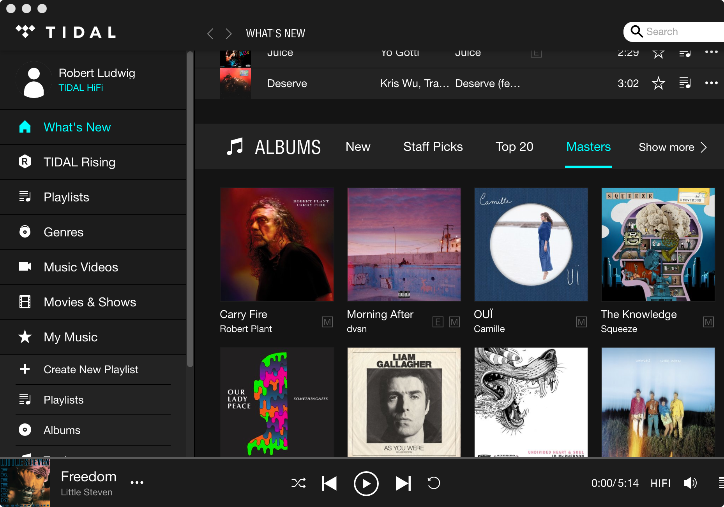
Audirvana, Amarra, Pure Music, TIDAL-MQA Masters etc. are programs that can by-pass the Apple Core Audio

Slide 33
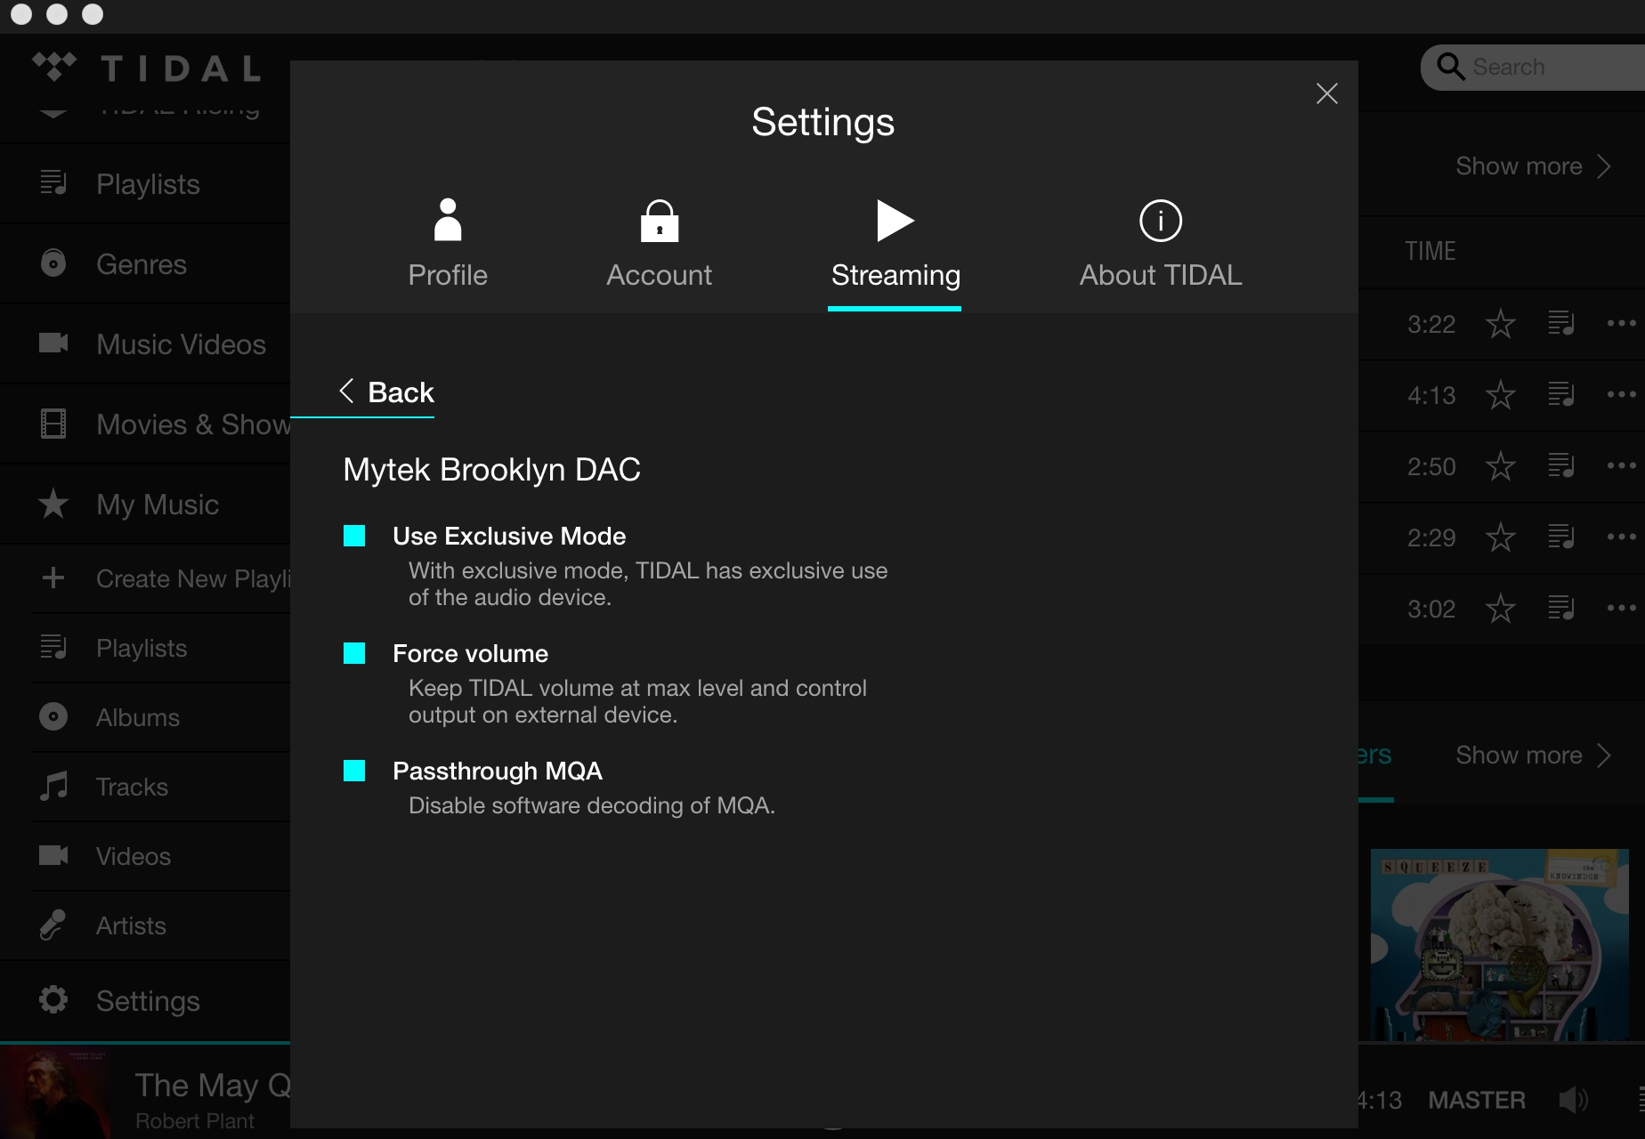

Slide 34
Just how “high resolution” is our hearing
in our analog world?
Frequency response 16 Hz-20 kHz
(relatively easy to reproduce)

Slide 35
Just how “high resolution” is our hearing
in our analog world?
Frequency response 16 Hz-20 kHz
(relatively easy to reproduce)
Dynamic range up to 140dB

Slide 36
Just how “high resolution” is our hearing
in our analog world?
Frequency response 16 Hz-20 kHz
(relatively easy to reproduce)
Dynamic range up to 140dB
A real-world concert hall
can yield 80dB of dynamic range.

Slide 37
Time Domain:
Current psycho-physics has shown that our
hearing can resolve impulses as fast as
less than 10μs (less than 10/ millionths of a second.
(This evolved from our ‘fight or flight’ response)

Slide 38
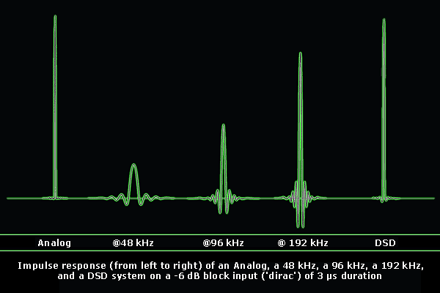
Reproduction of a 3 microsecond pulse

Slide 39
Time Domain:
High resolution digital audio is thus
an emphasis on Time Domain rather than
Frequency Domain

Slide 40
Unlike analog, all digital anti-aliasing filters have
“pre-ringing”, sound before the sound!
This blurs the sound. The higher sample
rates improve this situation, but even recording at 352.8kHz has some audible blur.

Slide 41
Unlike analog, all digital anti-aliasing filters have
“pre-ringing”, sound before the sound!
This blurs the sound. The higher sample
rates improve this situation, but even recording at 352.8kHz has some audible blur.

Slide 42
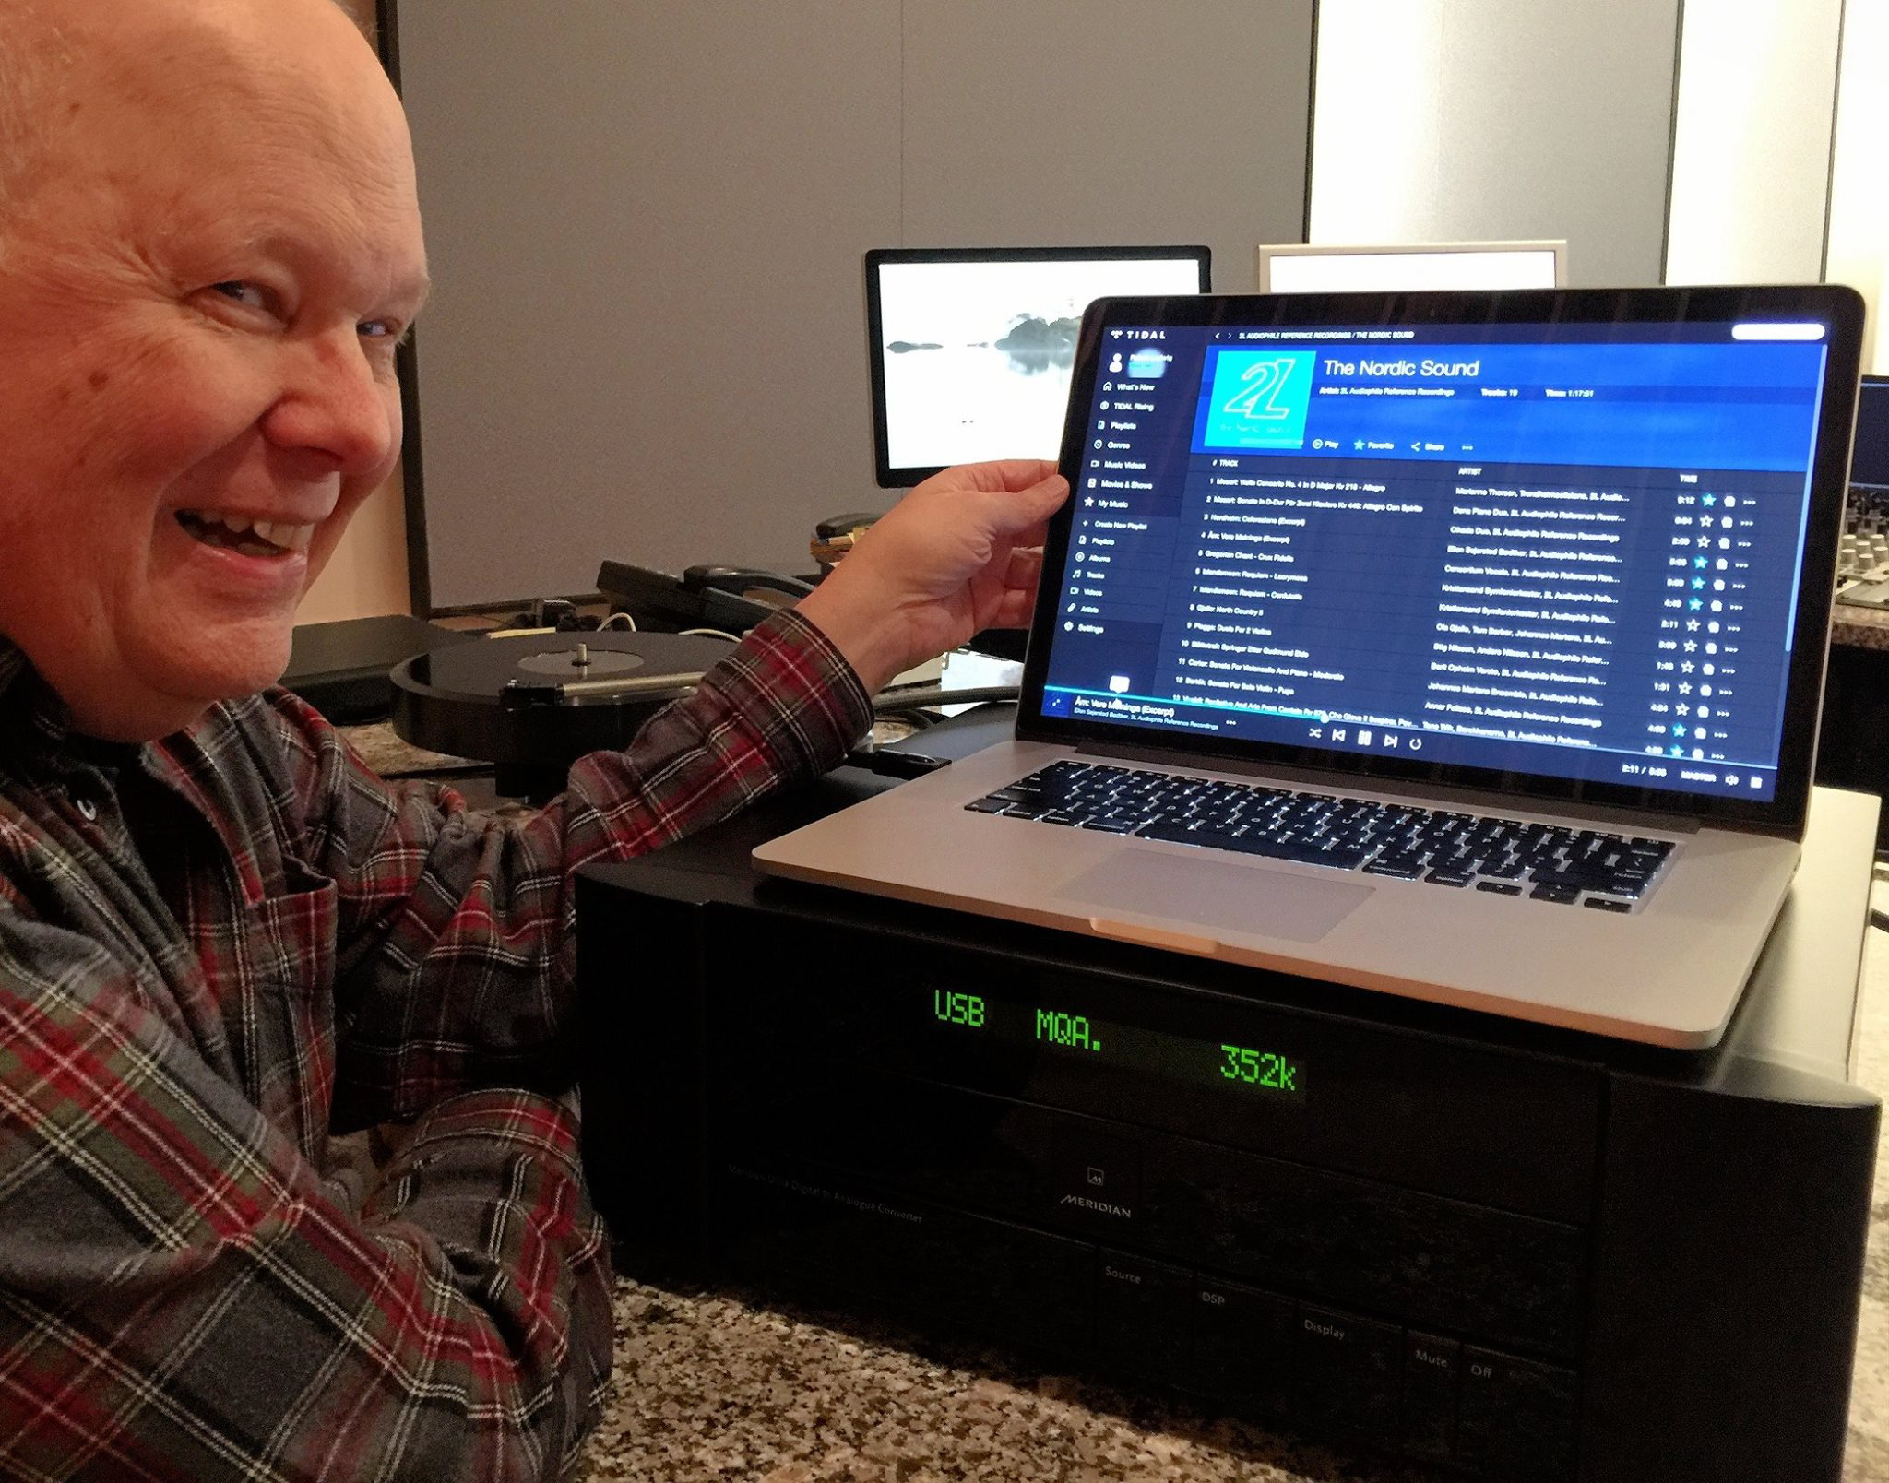

Slide 43
TAKE ME THERE
Peter Craven and Bob Stuart etc. from Meridian Audio originally invented “MLP” = Meridian Lossless Packing for making the high sample rates of DVD-Audio authoring possible.
Now they have invented MQA, “Master Quality Authenticated”
It is a method for packing high definition digital into a streamable and easily downloaded file.

Slide 44
Two articles about how MQA works
http://worldmags.net/88556-hi-fi-news-record-review-april-2015.html
https://www.stereophile.com/content/ive-heard-future-streaming-meridians-mqa

Slide 45
Streaming is now king.
Streaming is now responsible for record companies double digit growth for the first time in a long time.
High Resolution digital will be included in most of the streaming services packages now or in the near future.

Slide 46
Vinyl

Slide 47
1kHz tone from Meridian DAC, thru SPL console & converted by Metric Halo ADC.

Slide 48
1 kHz tone from MRL test tape

Slide 49
1 kHz tone from NAB test record

Slide 50
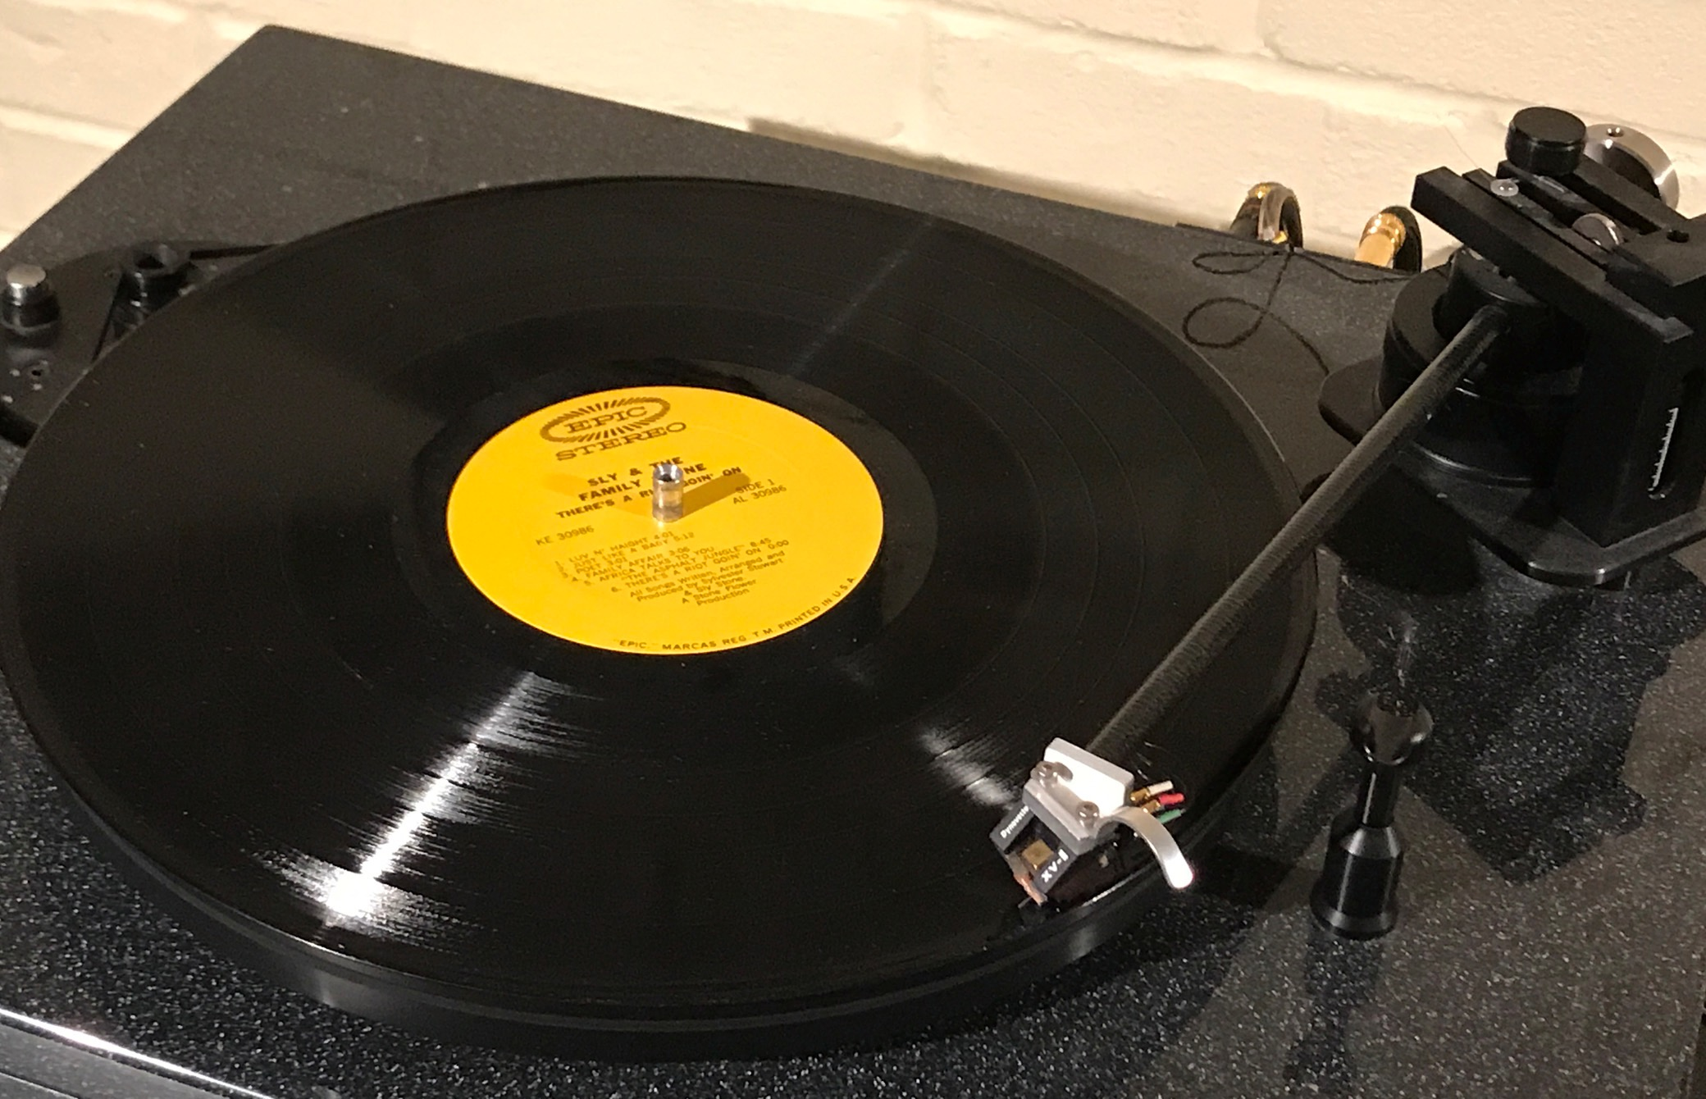
Vinyl’s playback resolution is a function of diameter:
a medium that is steadily collapsing as it plays!
Inner diameter: 8.27 ips
Outer diameter: 20 ips.
33/1/3 rpm

Slide 51
video of how
stampers are made for
pressing records
courtesy of Michael Fremer
It’s A Vinyl World, After All
Presently out of print, soon to come in BluRay.
https://goo.gl/NUqoKS

Slide 52
21st Century Michael Fremer's Practical Guide to Turntable Set-Up
DVD

Slide 53
Vinyl resolution is also a function of how flat
the back of the stamper is.
It is never perfect, so to some degree, the
“mold grain” noise on a pressing
is always added to the music!

Slide 54
5 sec. = the mold grain of a very big US plant,
5 sec. = a good German plant,
5 sec. = my favorite German plant, Pallas
x 3
Turned up a bit so you can compare more easily

Slide 55
Gateway Mastering Studios: Brinkmann Audio “Bardo”turntable & arm with “Pi” MC cartridge. SPL “Phonos” 120vDC rail preamp.

Slide 56
Vinyl is fairly quiet above 700 Hz, lows are noisy
John Eargle: Performance Characteristics of the Commercial Stereo Disk
AES April 30,1969

Slide 57
Playback distortion greatly increases on inner diameters

Slide 58
High frequency reproduction a function of diameter

Slide 59
Vinyl recordings have wow from being off-center
The resolution of the wow is a physical function of how accurately centered the stamper is on the press.
a survey of center-hole accuracy of 100 disks:

Slide 60
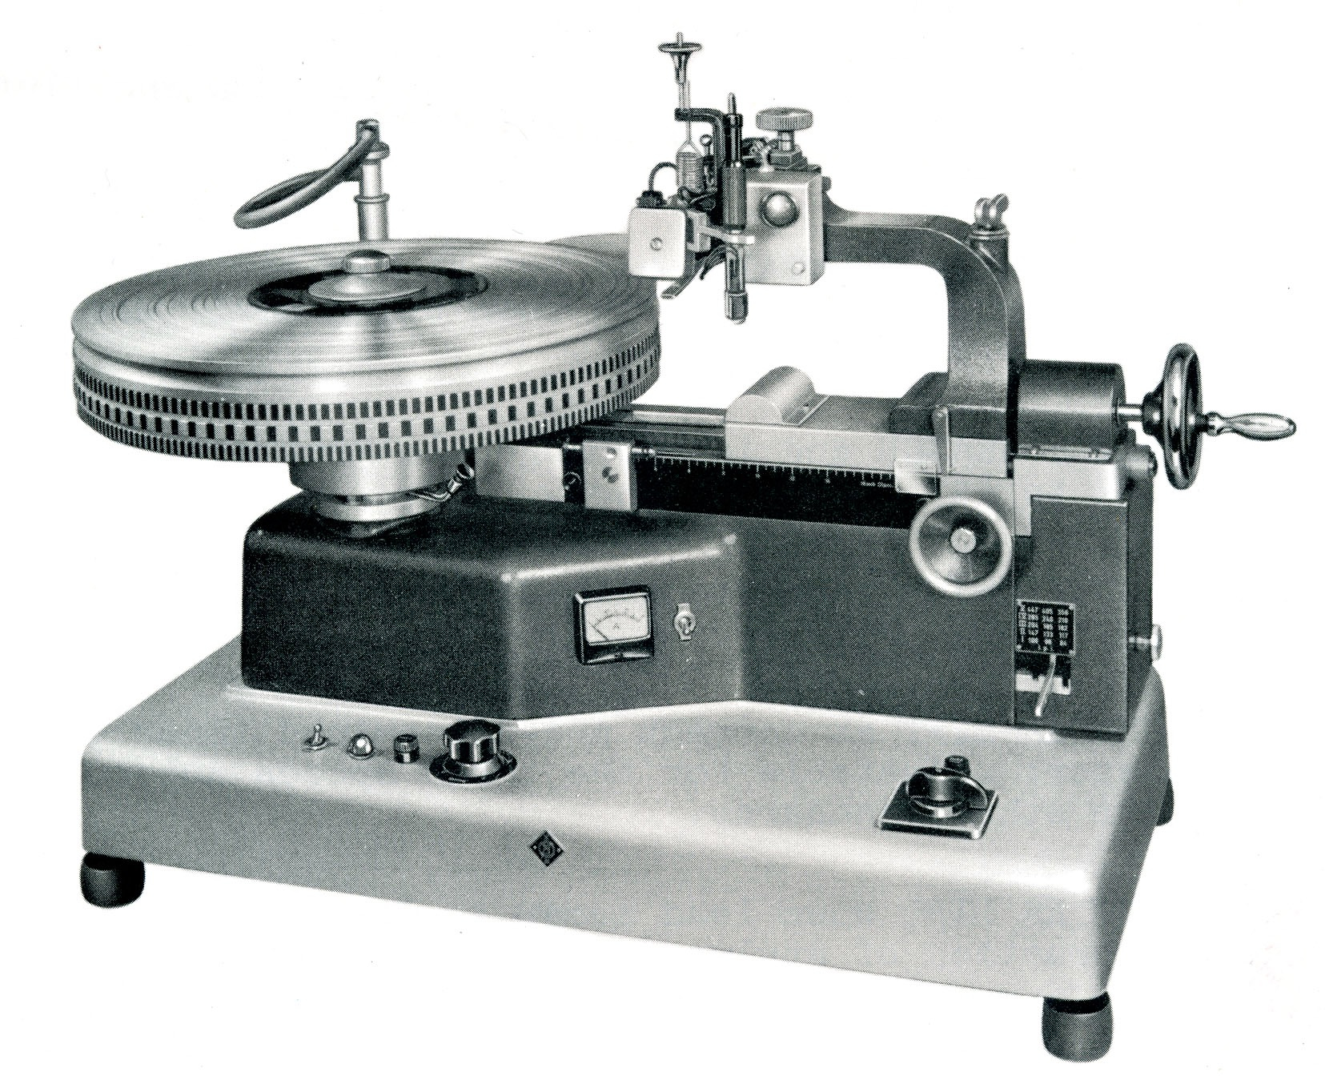
Bob’s first gear-driven lathe at A&R Recording with Phil Ramone

Slide 61
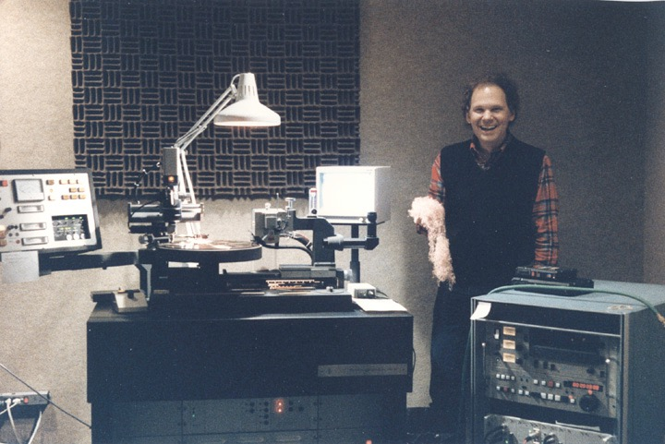
Direct Metal Mastering lathe Bob with copper cut from disk Sony PCM 1630
Bob’s last lathe at Masterdisk Corporation

Slide 62
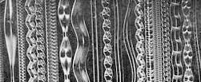
How “smart” is the computer control on the lathe?
Computers can nestle grooves as perfectly as possible
saving space.

Slide 63
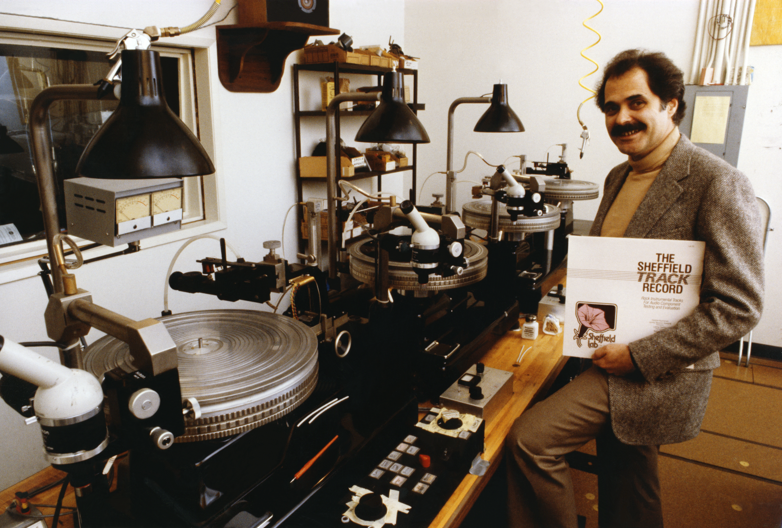
Doug Sax’s direct-to-disk set-up at the MGM Studios

Slide 64
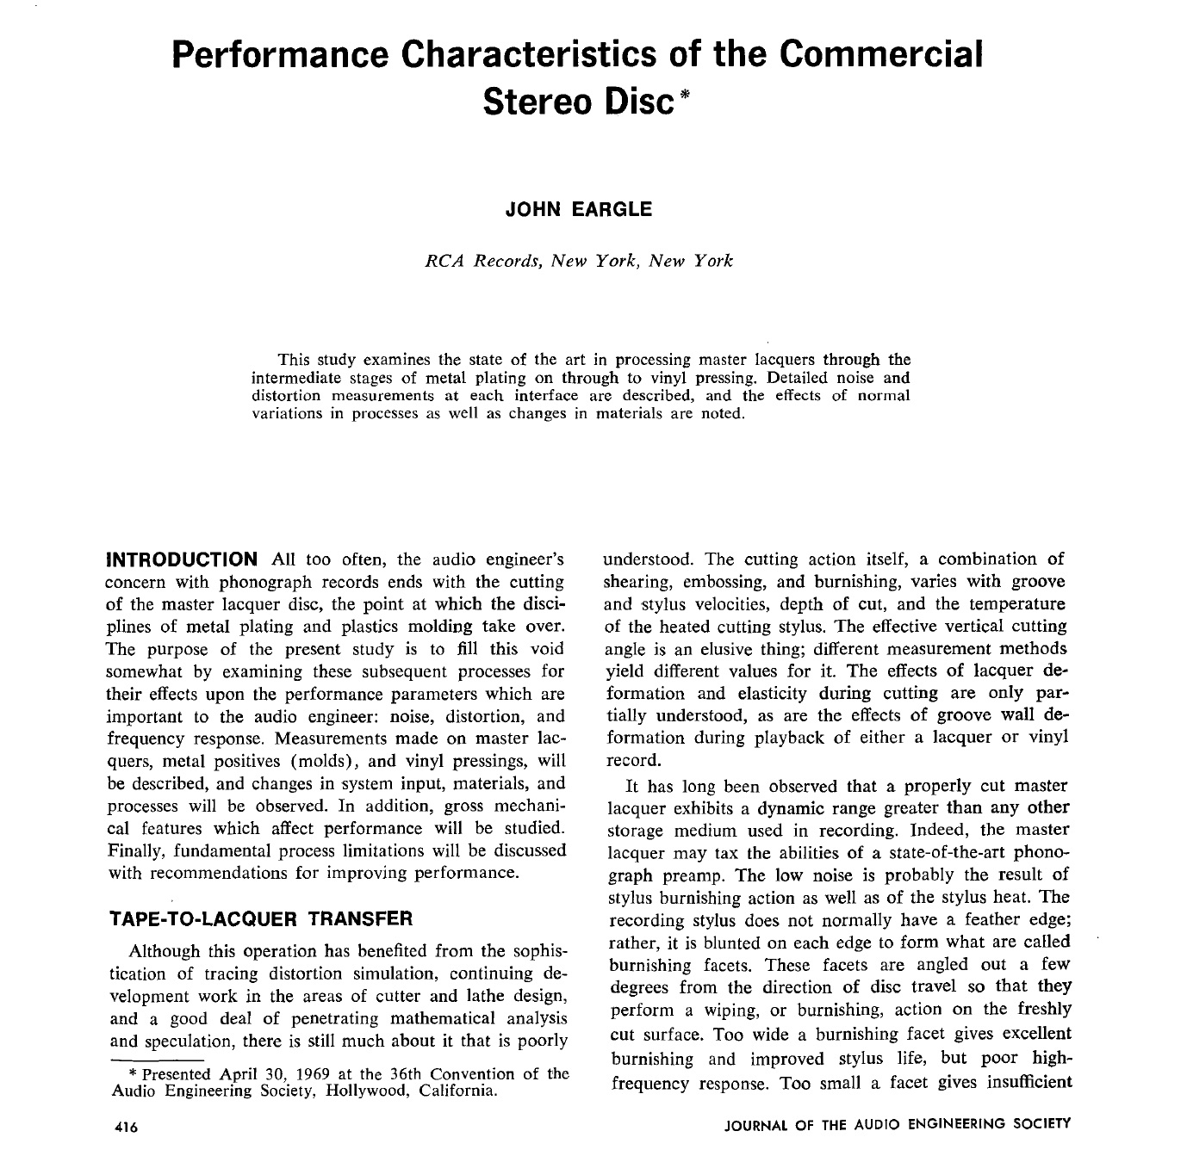

Slide 65
Tips for approving Test Pressings

Slide 66
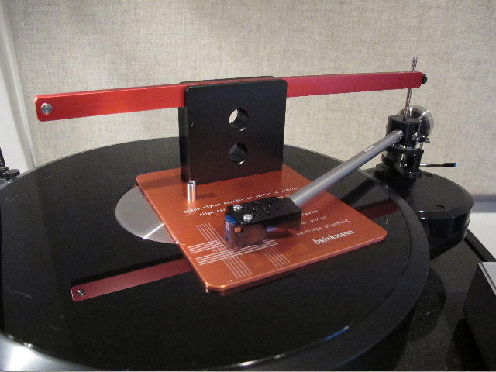
Be sure your turntable is properly aligned.
See Michael Fremer’s alignment DVDs

Slide 67
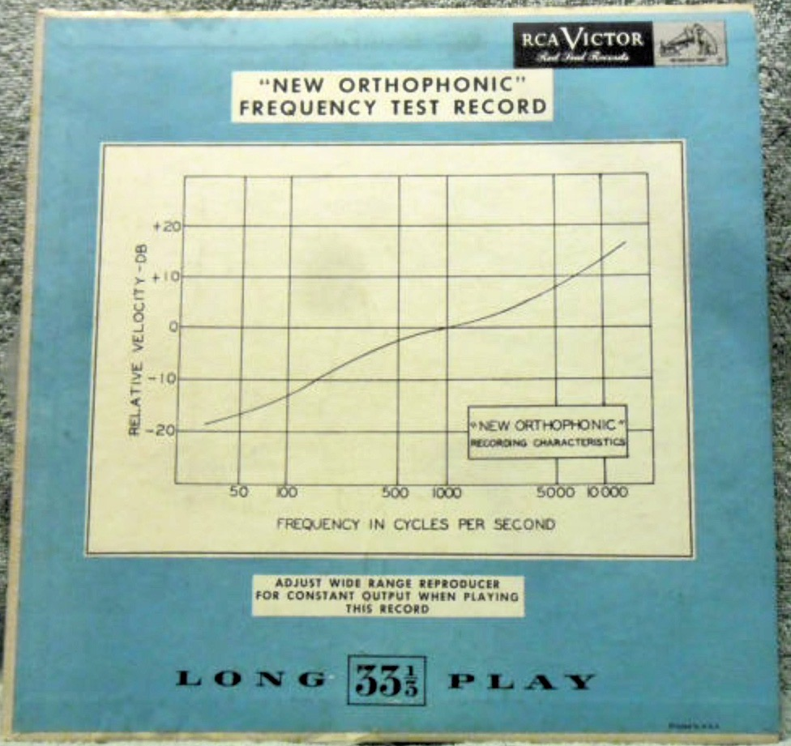
Vinyl test pressing evaluation
First be sure your system is properly aligned
and calibrated with an approved test disk to check
the frequency response.

Slide 68
Vinyl defects :
Ticks & pops
Stamper not centered accurately
Vinyl stamper mould grain noisy
“Pre-echo” one can hear the start of a track
1 or 2 revolutions before it actually plays
Warping, adds to wow
Skipping, must hear 100% of a test, including
the lock-out groove at the end.

Slide 69
Vinyl test pressing evaluation form:
Date:
Disk cutter:
Plant:
# of test pressings sent:
Side A: sound quality, a good match to source?
Is the stamper eccentric or properly centered?
Record the playback so one can go back and
check ticks & defects and time them accurately
for your test pressing report.

Slide 70
Bob Ludwig’s studio at Gateway Mastering Studios

